Slide 1


TOPIC 2
The Expected Utility Theory
Payoff associated with an action whose outcome is uncertain
Actions, Outcomes, & Payoffs (Ordinal)
+ Likelihood of each outcome
Continuous Functions
+ Intensity of Preferences
SECTION 1
The Single-Person Decision Problem
= Payoff
TOPIC 1
The Rational Choice Paradigm
Decision-making under uncertainty
Class 7a
Module 1: Actions, Outcomes, & Preferences
Module 2: The Payoff Function
Module 3: Continuous Action Spaces
Module 4: Decision Trees
Module 5: The Rational Player
Module 1: Uncertain Outcomes & Lotteries
One Action → Multiple Outcomes
Module 3: Continuous Outcome Spaces
Module 2: Expected Payoff

Slide 2

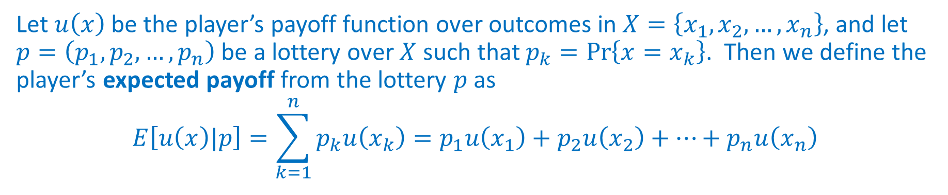

Expected Payoff
REVIEW
…estimate of what the decision-maker gets on average
cardinal
Let $u\left(x\right)$ be the player’s payoff function over outcomes in $X=\left\{x_{1}, x_{2},…, x_{n}\right\}$, and let $p=\left(p_{1},p_{2}, …, p_{n}\right)$ be a lottery over $X$ such that $p_{k}=\operatorname{Pr}\left\{x=x_{k}\right\}$. Then we define the player’s expected payoff from the lottery $p$ as
$$E\left[u\left(x\right)|p\right]=\sum_{k=1}^{n}{p_{k}u\left(x_{k}\right)}=p_{1}u\left(x_{1}\right)+p_{2}u\left(x_{2}\right)+…+p_{n}u\left(x_{n}\right)$$
$$v\left(a\right)$$
Notation
$$X$$ | Set of outcomes
$x_{1}$, $x_{2}$,… | Outcomes (Elements of $X$)
$$u\left(x_{k}\right)$$ | Payoff from outcome $x_{k}$
$$p\left(x_{k}\right)$$ | Probability that outcome $x_{k}$ occurs
…modify?
Outcome Space
Discrete
Continuous

Slide 3


MODULE 3 Continuous Outcome Spaces
500 mL
One action
Expected payoffs?
Infinitely-many outcomes

Slide 4

DECISION PROBLEM
Exam Prep & Grades
REVIEW
EXAMPLE
Goal: Assign a payoff to each action
Chapters: 1, 2, 3
A, B, C, D, F
Actions
$$A=\left\{0, 1, 2, 3\right\}$$
Number of chapters studied
Discrete action set
CASE 1
Each action leads to a single outcome.
Outcomes are deterministic variables.
Action | Description | Outcome (Grade) | Payoff (Grade Point)
$$a=0$$ | Don’t study | $$F$$ | $$0$$
$$a=1$$ | Study chapter 1 | $$C$$ | $$6$$
$$a=2$$ | Study chapters 1 & 2 | $$B$$ | $$8$$
$$a=3$$ | Study all 3 chapters | $$A$$ | $$10$$
One Action →
One Outcome
No uncertainty

Slide 5



















DECISION PROBLEM
Exam Prep & Grades
REVIEW
Independent
Nature: Outside the control of the decision maker
EXAMPLE
Goal: Assign a payoff to each action
Chapters: 1, 2, 3
A, B, C, D, F
Actions
$$A=\left\{0, 1, 2, 3\right\}$$
Number of chapters studied
Discrete action set
DISCRETE
CASE 2.1
Each action leads to multiple outcomes.
Outcomes are random variables.
Same outcome-payoffs
Different lottery
$$E\left(a\right)=\sum_{k=1}^{5}{p\left(x_{k}\right)u\left(x_{k}\right)}$$
$$x_{1}=A$$
$$p\left(x_{1}\right)=0.3$$
$$u\left(x_{1}\right)=10$$
$$x_{2}=B$$
$$p\left(x_{2}\right)=0.5$$
$$u\left(x_{2}\right)=8$$
$$E\left(2\right)=0.3×10+0.5×8+0.2×6$$
$$a=2$$
$$x_{3}=C$$
$$p\left(x_{3}\right)=0.2$$
$$u\left(x_{3}\right)=6$$
$$x_{4}=D$$
$$p\left(x_{4}\right)=0.0$$
$$∴E\left(2\right)=8.2$$
$$u\left(x_{4}\right)=4$$
$$x_{5}=F$$
$$p\left(x_{5}\right)=0.0$$
$$u\left(x_{5}\right)=0$$
…and so on for the remaining three actions
Probability of each outcome
Cardinal payoff of each outcome
= Expected payoff of action
Discrete outcomes =
Discrete probability distribution
Cardinal payoffs
Lottery
Different for different decision-makers

Slide 6

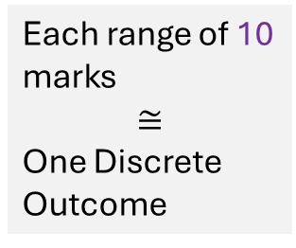
DECISION PROBLEM
Exam Prep & Grades
Expected Payoff $≅∑\left(Probability×Average Marks in Range\right)$
EXAMPLE
Goal: Assign a payoff to each action
Chapters: 1, 2, 3
A, B, C, D, F
Number of chapters studied
Discrete action set
Expected Payoff
Actions
Number of chapters studied
Actions
$$A=\left\{0, 1, 2, 3\right\}$$
$$A=\left\{0, 1, 2, 3\right\}$$
CONTINUOUS
~ DISCRETE
CASE 2.2
Each action leads to multiple outcomes.
Outcomes are random variables.
Outcome (Marks) | Probability
$$0−10$$ | $$0$$
$$10−20$$ | $$0$$
$$20−30$$ | $$0$$
$$30−40$$ | $$0$$
$$40−50$$ | $$0$$
$$50−60$$ | $$0$$
$$60−70$$ | $$0.2$$
$$70−80$$ | $$0.5$$
$$80−90$$ | $$0.3$$
$$90−100$$ | $$0$$
…temperature on the campus tomorrow
$$a=2$$
$$X=\left[0, 100\right]$$
Marks
Each range of 10 marks
$$≅$$
One Discrete Outcome
Continuous, Infinitely-many outcomes
Probability of each outcome $=0$
Expected payoff of $a$?
Lottery: Assign probabilities to ranges of outcomes

Slide 7
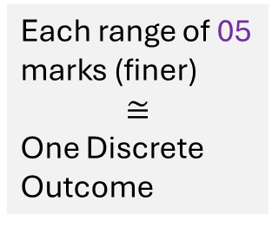
DECISION PROBLEM
Exam Prep & Grades
Expected Payoff $≅∑\left(Probability×Average Marks in Range\right)$
EXAMPLE
Goal: Assign a payoff to each action
Chapters: 1, 2, 3
Actions
$$A=\left\{0, 1, 2, 3\right\}$$
Number of chapters studied
Discrete action set
CONTINUOUS
~ DISCRETE
CASE 2.2
Each action leads to multiple outcomes.
Outcomes are random variables.
Outcome (Marks) | Probability
$$0−5$$ | $$0$$
$$5−10$$ | $$0$$
$$…$$ | $$0$$
$$60−65$$ | $$0.09$$
$$65−70$$ | $$0.11$$
$$70−75$$ | $$0.22$$
$$75−80$$ | $$0.28$$
$$80−85$$ | $$0.17$$
$$85−90$$ | $$0.13$$
$$90−100$$ | $$0$$
$$a=2$$
Each range of 05 marks (finer)
$$≅$$
One Discrete Outcome

Slide 8
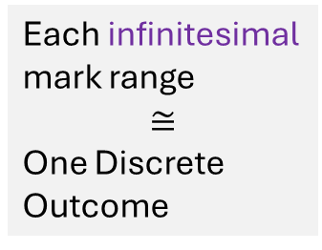
DECISION PROBLEM
Exam Prep & Grades
Expected Payoff $≅∑\left(Probability×Average Marks in Range\right)$
EXAMPLE
Goal: Assign a payoff to each action
Chapters: 1, 2, 3
Actions
$$A=\left\{0, 1, 2, 3\right\}$$
Number of chapters studied
Discrete action set
CONTINUOUS
~ DISCRETE
CASE 2.2
Each action leads to multiple outcomes.
Outcomes are random variables.
Outcome (Marks) | Probability
$$0−5$$ | $$0$$
$$5−10$$ | $$0$$
$$…$$ | $$0$$
$$60−65$$ | $$0.09$$
$$65−70$$ | $$0.11$$
$$70−75$$ | $$0.22$$
$$75−80$$ | $$0.28$$
$$80−85$$ | $$0.17$$
$$85−90$$ | $$0.13$$
$$90−100$$ | $$0$$
Probability Density Function
CONTINUOUS
$$a=2$$
Each infinitesimal mark range
$$≅$$
One Discrete Outcome
…not the probability of individual outcomes
…probabilities of infinitesimal ranges of outcomes

Slide 9








Cumulative Distribution Function (CDF)
MATH
One action → Infinitely-many outcomes
Instead, we specify the cumulative probability that the outcome will be less than or equal to a certain value.
Probability of each individual outcome $=0$
CDF
Discrete probability distribution
$$F\left(x\right)=\operatorname{Pr}\left\{outcome≤x\right\}$$
$$0≤F\left(x\right)≤1$$
$x_{0}$ = winnings from the lottery
…continuous random variable
The probability of winning exactly ₹1 Lakh is $0$.
Probability of one outcome
$$\operatorname{Pr}\left\{x_{0}=1\right\}=0$$
Outcomes
$$X=\left[0, 10\right]$$
The probability of winning up to ₹1 Lakh is $0.1$.
Cumulative probability
$$\operatorname{Pr}\left\{x_{0}≤1\right\}=0.1$$
$$F\left(1\right)=0.1$$

Slide 10
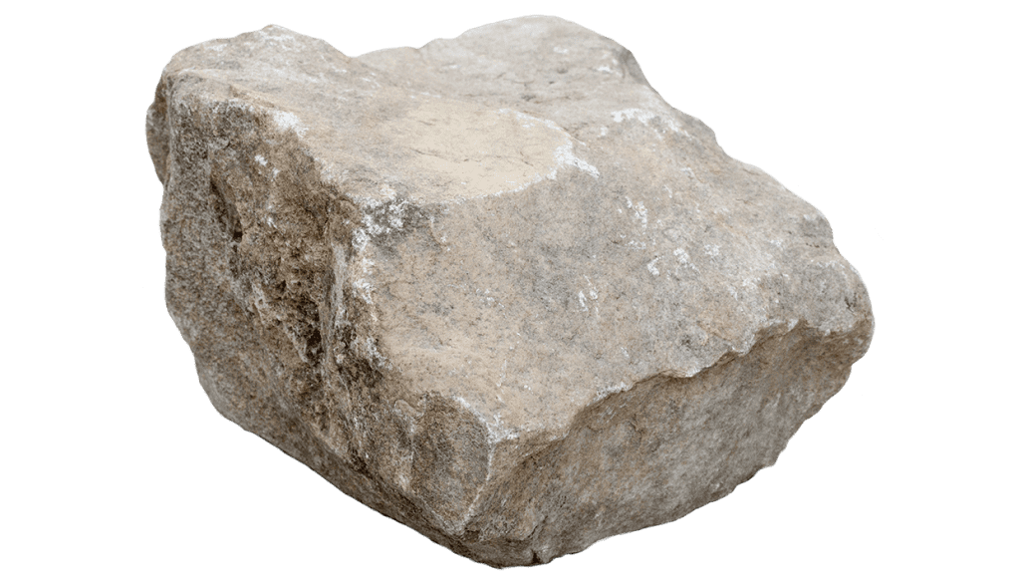


Cumulative Distribution Function (CDF)
MATH
$x=$Your daily mood rating
Normal CDF
$$F\left(+3\right)=1$$
THE ANALOGY
STONE – RANDOM VARIABLE
Mass – Probability
Geometric Point – Single outcome
Mass at a Point = Probability of Single Outcome = 0
Particle (Control Volume) = Range of Outcomes
Mass of a Particle = Probability that outcome lies in a certain range = nonzero
CDF: Cumulative Mass vs. Volume Considered – Cumulative Probability vs. Outcome value
Vertical Axis Range: (0 – Total Mass) – (0 to 1)
Slope of CDF Curve: Mass Density ($dM/dV$) – Probability Density ($dF/dx$)
$$F\left(1\right)=\operatorname{Pr}\left\{x_{0}≤1\right\}$$
Outcome $x_{0}$
$$−3≤x_{0}≤+3$$
…continuous random variable
CDF
Cumulative Probability ($F\left(x\right)$)
Cumulative Mass
Non-decreasing function
$$F\left(x\right)=\operatorname{Pr}\left\{x_{0}≤x\right\}$$
$$F\left(−1\right)=\operatorname{Pr}\left\{x_{0}≤−1\right\}$$
Flat
CDF → PDF → Expected Payoff
Probability that the outcome is between $x_{l}$ and $x_{h}$
Outcome ($x$)
Volume Considered
$$F\left(−3\right)=0$$
$$x_{0}≤−1$$
$$x_{0}≤1$$
$$\operatorname{Pr}\left\{x_{0}≤x_{l}\right\}=F\left(x_{l}\right)$$
$$\operatorname{Pr}\left\{x_{0}≤x_{h}\right\}=F\left(x_{h}\right)$$
When outcomes are continuous and uncertain, the CDF allows us to assign probabilities to specific ranges of outcomes.
$$\operatorname{Pr}\left\{{x_{l}≤x}_{0}≤x_{h}\right\}=F\left(x_{h}\right)−F\left(x_{l}\right)$$

Slide 11


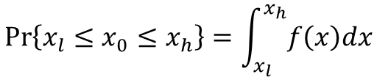

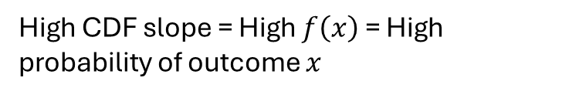
Probability Density Function (PDF)
MATH
Normal Distribution
$$f=\frac{dF}{dx}$$
Slope of the CDF curve: Contribution of that outcome to the cumulative probability
Probability Density ($f\left(x\right)$)
High CDF slope = High $f\left(x\right)$ = High probability of outcome $x$
Flat
Outcome ($x$)
Probability that the outcome is between $x_{l}$ and $x_{h}$
$$\operatorname{Pr}\left\{{x_{l}≤x}_{0}≤x_{h}\right\}=F\left(x_{h}\right)−F\left(x_{l}\right)$$
Area under curve = 1
$$\operatorname{Pr}\left\{{x_{l}≤x}_{0}≤x_{h}\right\}=\int_{x_{l}}^{x_{h}}{f\left(x\right)dx}$$

Slide 12
A Simple Lottery Over Continuous Outcomes
Modeling Uncertainty
A simple lottery over an interval $X=\left[\underline{x}, \overline{x}\right]$ is given by a cumulative distribution function $F :X →\left[0, 1\right]$, where $F\left(\hat{x}\right)=\operatorname{Pr}\left\{x≤\hat{x}\right\}$ is the probability that the outcome is less than or equal to $\hat{x}$.
Notation
$$X$$ | Interval of outcomes
$$\underline{x}$$ | Lower limit of interval $X$
$$\overline{x}$$ | Upper limit of interval $X$
$$F\left(\hat{x}\right)$$ | Probability that the outcome $x≤\hat{x}$

Slide 13


Expected Payoff for Continuous Outcomes
EXAMPLE
$$A=\left\{B, N\right\}$$
CDF
$$F\left(x\right)=\frac{1−e^{−0.2x}}{1−e^{−2}}$$
$$X=\left[0, 10\right]$$
…you can win between 0 and 10 lakhs
Continuous outcome space
PDF
$$f\left(x\right)=\frac{dF}{dx}=\frac{0.2e^{−0.2x}}{1−e^{−2}}$$
Discrete probability distribution
Payoffs
$$u\left(x\right)=x$$

Slide 14



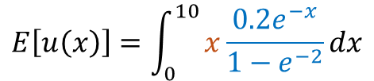




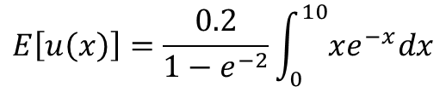

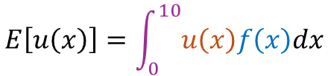






Expected Payoff for Continuous Outcomes
EXAMPLE
Expected Payoff: an average of payoffs weighted by the probability of each outcome.
$$I=−xe^{−x}+\int{e^{−x}}dx$$
Integral
$$f\left(x\right)$$
$$v\left(B\right)=$$
$$u\left(x\right)$$
$$E\left[u\left(x\right)\right]=\int_{0}^{10}{u\left(x\right)f\left(x\right)dx}$$
PDF
$$I=−xe^{−x}+\frac{e^{−x}}{−1}$$
$$f\left(x\right)$$
Continuous functions
Payoff ($u\left(x\right)$)
$$I=−xe^{−x}−e^{−x}$$
$$E\left[u\left(x\right)\right]=\int_{0}^{10}{x\frac{0.2e^{−x}}{1−e^{−2}}dx}$$
$$I=∫xe^{−x}dx$$
$$I=−e^{−x}\left(x+1\right)$$
$$I=x∫e^{−x}dx−∫\frac{d}{dx}\left(x\right)∫e^{−x}dx$$
$$E\left[u\left(x\right)\right]=\frac{0.2}{1−e^{−2}}\int_{0}^{10}{xe^{−x}dx}$$
$${\left[I\right]}_{0}^{10}=−e^{−10}\left(10+1\right)+e^{−0}\left(0+1\right)$$
$$I=x\frac{e^{−x}}{−1}−\int{\frac{e^{−x}}{−1}}dx$$
$${\left[I\right]}_{0}^{10}=1−{11e}^{−10}$$
Outcome ($x$)

Slide 15




Expected Payoff for Continuous Outcomes
EXAMPLE
Expected Payoff: an average of payoffs weighted by the probability of each outcome.
Integral
$$v\left(B\right)=$$
$$v\left(B\right)=$$
$$u\left(x\right)$$
$$f\left(x\right)$$
$$E\left[u\left(x\right)\right]=\int_{0}^{10}{u\left(x\right)f\left(x\right)dx}$$
PDF
$$E\left[u\left(x\right)\right]=0.2313$$
Continuous functions
$$E\left[u\left(x\right)\right]=\int_{0}^{10}{x\frac{0.2e^{−x}}{1−e^{−2}}dx}$$
$${\left[I\right]}_{0}^{10}=1−{11e}^{−10}$$
$$E\left[u\left(x\right)\right]=\frac{0.2}{1−e^{−2}}{\left[I\right]}_{0}^{10}$$
$$E\left[u\left(x\right)\right]=\frac{0.2}{1−e^{−2}}\int_{0}^{10}{xe^{−x}dx}$$
$$E\left[u\left(x\right)\right]=\frac{0.2}{1−e^{−2}}\left(1−{11e}^{−10}\right)$$

Slide 16
Expected Payoff for Continuous Outcomes
Let $u\left(x\right)$ be the player’s payoff function over outcomes in the interval $X=\left[\underline{x}, \overline{x}\right]$ with a lottery given by the cumulative distribution function $F\left(x\right)$, with density $f\left(x\right)$. Then we define the player’s expected payoff as
$$E\left[u\left(x\right)\right]=\int_{\underline{x}}^{\overline{x}}{u\left(x\right)f\left(x\right)dx}$$
Notation
$$X$$ | Interval of outcomes
$$\underline{x}$$ | Lower limit of interval $X$
$$\overline{x}$$ | Upper limit of interval $X$
$$u\left(x\right)$$ | Payoff from outcome $x$
$$f\left(x\right)$$ | Slope of the CDF curve at outcome $x$

Slide 17
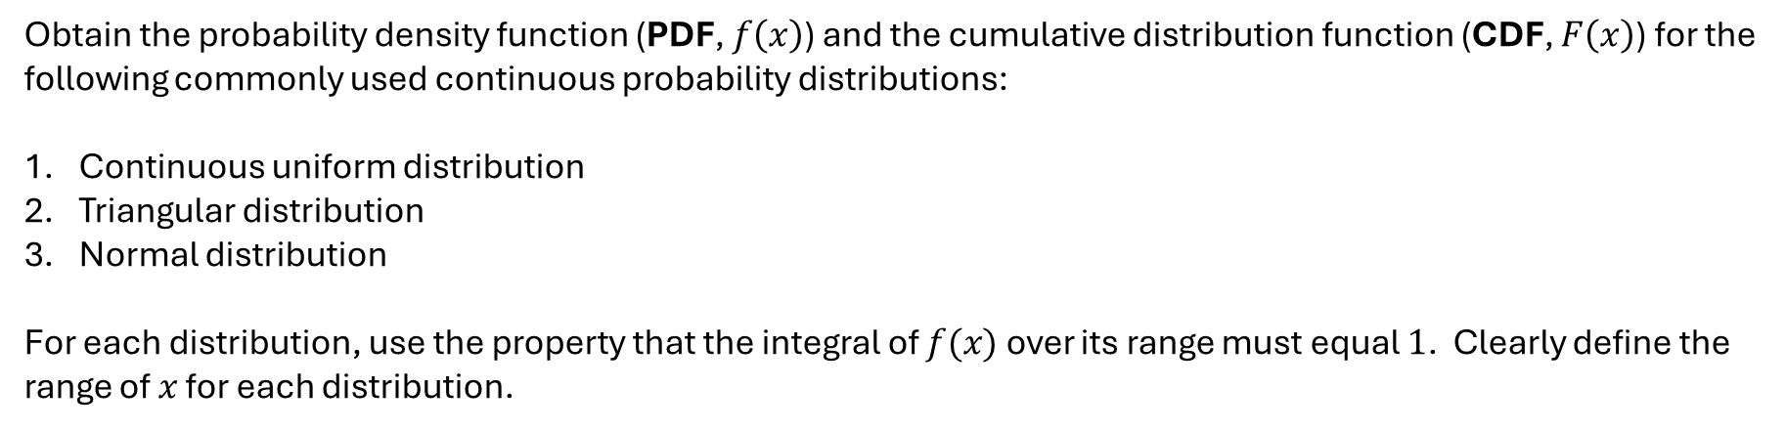
Continuous Probability Distributions
MATH
Obtain the probability density function (PDF, $f\left(x\right)$) and the cumulative distribution function (CDF, $F\left(x\right)$) for the following commonly used continuous probability distributions:
Continuous uniform distribution
Triangular distribution
Normal distribution
For each distribution, use the property that the integral of $f(x)$ over its range must equal $1$. Clearly define the range of $x$ for each distribution.
Continuous uniform distribution: Assigns equal probability to all values within a specified range and zero probability outside that range
Triangular distribution: Assigns higher probability to values near a peak, tapering off to zero at the boundaries of a specified range
Normal distribution: Concentrates probabilities around a central mean, forming a symmetric bell-shaped curve that extends infinitely in both directions

Slide 18














Continuous Uniform Distribution
MATH
Assigns equal probability to all values within a specified range and zero probability outside that range
$$x_{0}∈\left[a, b\right]$$
…all values between $a$ and $b$ are equally likely.
Probability Density Function
Cumulative Distribution Function
…$c$ is a constant yet to be determined.
$$=\int_{a}^{x}{f\left(t\right)dt}$$
$$f\left(x\right)=c$$
$$F\left(x\right)=\operatorname{Pr}\left\{x_{0}≤x\right\}$$
$$\int_{a}^{b}{f\left(x\right)}dx=1$$
…total probability must sum to $1$.
$$F\left(x\right)=\int_{a}^{x}{\frac{1}{b−a}dt}$$
$$F\left(x\right)=\frac{x−a}{b−a}$$
$$\int_{a}^{b}{c}dx=1$$
$$c\int_{a}^{b}{dx}=1$$
$$c=\frac{1}{b−a}$$
$$f\left(x\right)=\frac{1}{b−a}$$

Slide 19


Continuous Uniform Distribution
MATH
Assigns equal probability to all values within a specified range and zero probability outside that range
$$x_{0}∈\left[a, b\right]$$
…all values between $a$ and $b$ are equally likely.
Probability Density Function
Cumulative Distribution Function
$$f\left(x\right)=\left\{\begin{aligned}\frac{1}{b−a} \\ \\ 0\end{aligned} \begin{matrix}if x∈\left[a, b\right] \\ \begin{aligned} \\ \end{aligned} \\ otherwise\end{matrix}\right.$$
$$F\left(x\right)=\left\{\begin{aligned}0 \\ \\ \frac{x−a}{b−a} \\ \\ 1\end{aligned} \begin{matrix}\begin{aligned}if x<a \\ \end{aligned} \\ \begin{aligned}if x∈\left[a, b\right] \\ \end{aligned} \\ if x>b\end{matrix}\right.$$

Slide 20












Continuous Uniform Distribution
MATH
$$f\left(x\right)$$
$$F\left(x\right)$$
$$\frac{1}{b−a}$$
$$1$$
$$0$$
$$x=a$$
$$x=b$$
$$x$$
$$0$$
$$x=a$$
$$x=b$$
$$x$$

Slide 21











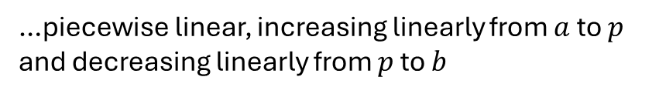







Triangular Distribution
MATH
Assigns higher probability to values near a peak, tapering off to zero at the boundaries of a specified range
$$x_{0}∈\left[a, b\right]$$
…triangular distribution with a peak at $x=p$
Probability Density Function
$$\left(p,\frac{2}{b−a}\right)$$
$$a≤x≤p$$
$$\left(a, 0\right)$$
$$\left(x, f\left(x\right)\right)$$
…piecewise linear, increasing linearly from $a$ to $p$ and decreasing linearly from $p$ to $b$
$$\frac{\frac{2}{b−a}−0}{p−a}=\frac{f\left(x\right)−0}{x−a}$$
$$f\left(x\right)=\frac{2\left(x−a\right)}{\left(b−a\right)\left(p−a\right)}$$
Let height of the PDF at $x=p$ be $h$.
The base of the triangle is $b−a$.
$$\left(p,\frac{2}{b−a}\right)$$
$$p<x≤b$$
$$\left(x, f\left(x\right)\right)$$
$$\left(b,0\right)$$
Area under the curve is $\frac{1}{2}×base×height=$ 1
$$\frac{0−\frac{2}{b−a}}{b−p}=\frac{0−f\left(x\right)}{b−x}$$
$$f\left(x\right)=\frac{2\left(b−x\right)}{\left(b−a\right)\left(b−p\right)}$$
$$\frac{1}{2}\left(b−a\right)h=1$$
$$h=\frac{2}{b−a}$$

Slide 22

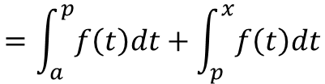



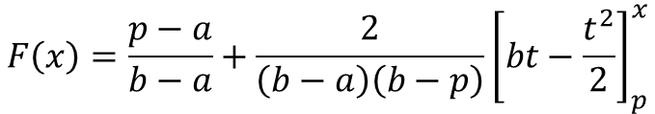



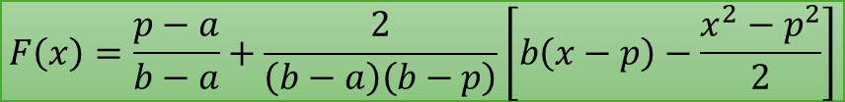
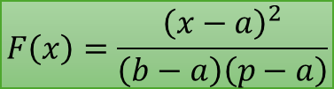

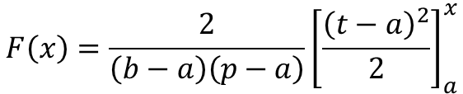
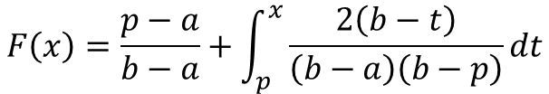
Triangular Distribution
MATH
Assigns higher probability to values near a peak, tapering off to zero at the boundaries of a specified range
$$x_{0}∈\left[a, b\right]$$
…triangular distribution with a peak at $x=p$
Cumulative Distribution Function
$$a≤x≤p$$
$$p<x≤b$$
$$=\int_{a}^{x}{f\left(t\right)dt}$$
$$=\int_{a}^{p}{f\left(t\right)dt}+\int_{p}^{x}{f\left(t\right)dt}$$
$$F\left(x\right)=\operatorname{Pr}\left\{x_{0}≤x\right\}$$
$$F\left(x\right)=\operatorname{Pr}\left\{x_{0}≤x\right\}$$
$$F\left(x\right)=\int_{a}^{x}{\frac{2\left(t−a\right)}{\left(b−a\right)\left(p−a\right)}dt}$$
$$F\left(x\right)=\frac{p−a}{b−a}+\int_{p}^{x}{\frac{2\left(b−t\right)}{\left(b−a\right)\left(b−p\right)}dt}$$
$$F\left(x\right)={\frac{2}{\left(b−a\right)\left(p−a\right)}\left[\frac{{\left(t−a\right)}^{2}}{2}\right]}_{a}^{x}$$
$$F\left(x\right)=\frac{p−a}{b−a}+\frac{2}{\left(b−a\right)\left(b−p\right)}{\left[bt−\frac{t^{2}}{2}\right]}_{p}^{x}$$
$$F\left(x\right)=\frac{{\left(x−a\right)}^{2}}{\left(b−a\right)\left(p−a\right)}$$
$$F\left(x\right)=\frac{p−a}{b−a}+\frac{2}{\left(b−a\right)\left(b−p\right)}\left[b\left(x−p\right)−\frac{x^{2}−p^{2}}{2}\right]$$

Slide 23

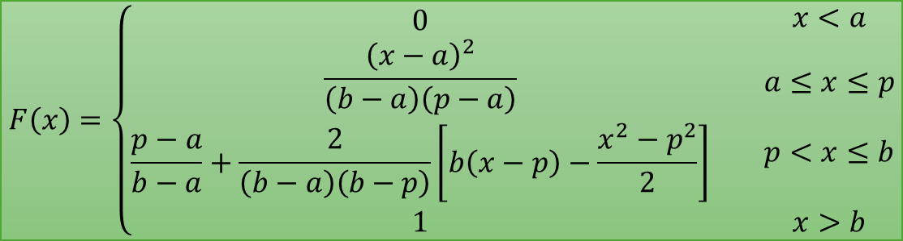
Triangular Distribution
MATH
Assigns higher probability to values near a peak, tapering off to zero at the boundaries of a specified range
$$x_{0}∈\left[a, b\right]$$
…triangular distribution with a peak at $x=p$
Probability Density Function
Cumulative Distribution Function
$$f\left(x\right)=\left\{\begin{aligned}\frac{2\left(x−a\right)}{\left(b−a\right)\left(p−a\right)} \\ \frac{2\left(b−x\right)}{\left(b−a\right)\left(b−p\right)} \\ 0\end{aligned} \begin{matrix}a≤x≤p \\ \begin{aligned} \\ p<x≤b \\ \end{aligned} \\ otherwise\end{matrix}\right.$$
$$F\left(x\right)=\left\{\begin{aligned}\begin{aligned}0 \\ \frac{{\left(x−a\right)}^{2}}{\left(b−a\right)\left(p−a\right)}\end{aligned} \\ \frac{p−a}{b−a}+\frac{2}{\left(b−a\right)\left(b−p\right)}\left[b\left(x−p\right)−\frac{x^{2}−p^{2}}{2}\right] \\ 1\end{aligned} \begin{aligned}x<a \\ \\ \begin{aligned}a≤x≤p \\ \end{aligned} \\ \begin{aligned}p<x≤b \\ \end{aligned} \\ x>b\end{aligned}\right.$$

Slide 24
Random Variables
SUMMARY
MATH
A random variable describes a chance-determined variable that can equal one of many different values, each with an associated probability.
The set of possible values is called the sample space of the distribution.
The function that describes the relative frequency of the possible values that can be realized by a random variable is called a probability distribution.

Slide 25
Discrete Random Variables
SUMMARY
MATH
A discrete random variable can result in one of a discrete set of values.
For discrete and finite random variables, the probability distribution associates each outcome in the sample space with a probability.
The expected value of a discrete real-valued random variable is equal to the probability-weighted average of all the possible values that can be realized.

Slide 26
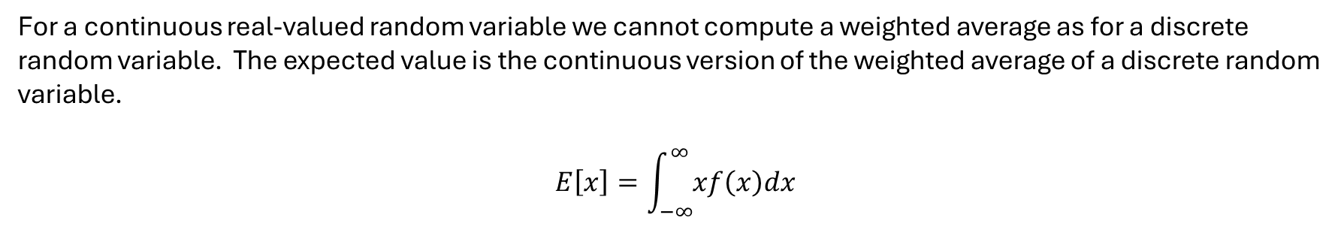
Continuous Random Variables
SUMMARY
MATH
A continuous random variable can result in a value drawn from an interval or continuum of values.
A continuous random variable cannot be represented by a probability distribution and instead is defined by its cumulative distribution function.
If the CDF $F$ of a continuous distribution is differentiable then it has a derivative $f = F^{′}$, which is called the probability density function, $f\left(x\right)$.
For a continuous real-valued random variable we cannot compute a weighted average as for a discrete random variable. The expected value is the continuous version of the weighted average of a discrete random variable.
$$E\left[x\right]=\int_{−∞}^{∞}{xf\left(x\right)dx}$$

